Slide 1

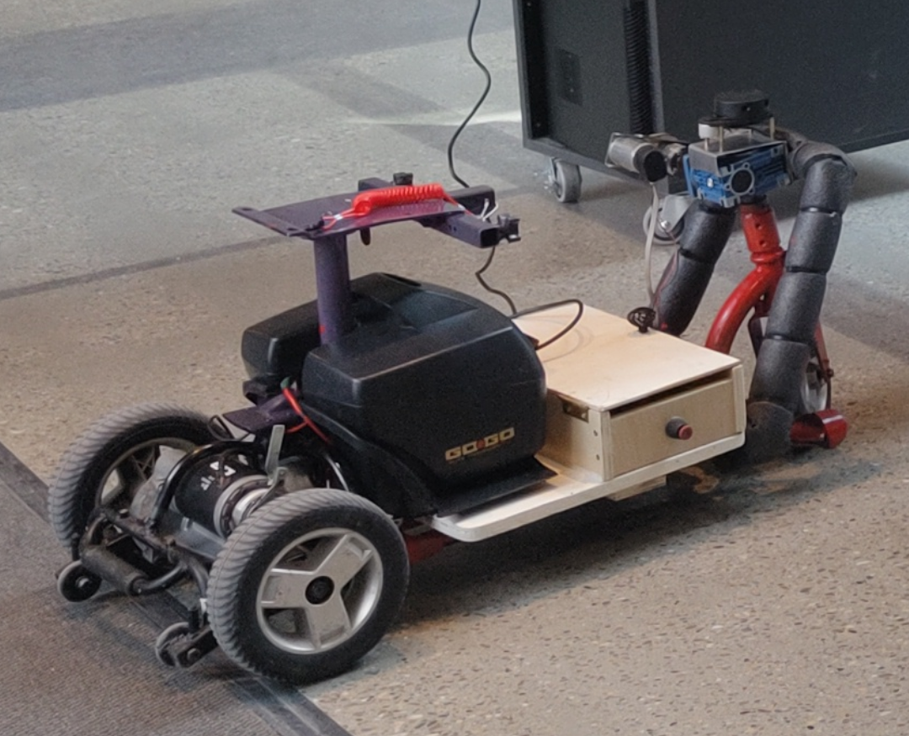

Campus Automated guided vehicle Capstone
Prepared by:
Paulo Dongala,
Jasrajdeep Singh Jassar
Jake Joustra
Ryan Laguna
Prepared for:
Daniel Barrett,
Christopher Dick
April 18, 2024

Slide 2
Agenda
Project Background
Problem Statement
Limitations
Constraints
Design Concept
Design Criteria
Prototyping
Conclusion
Recommendations
Questions

Slide 3
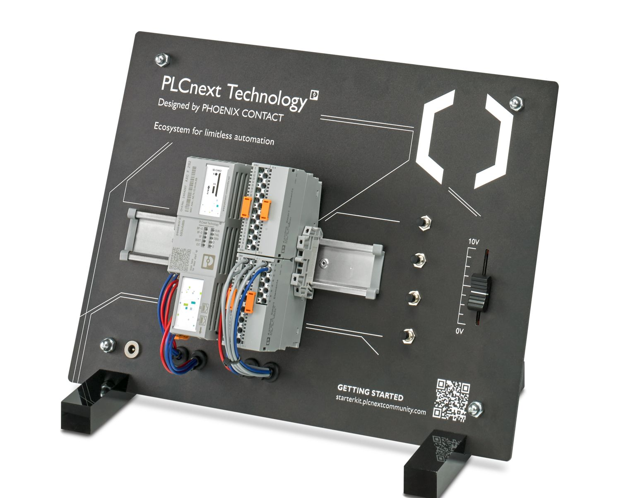
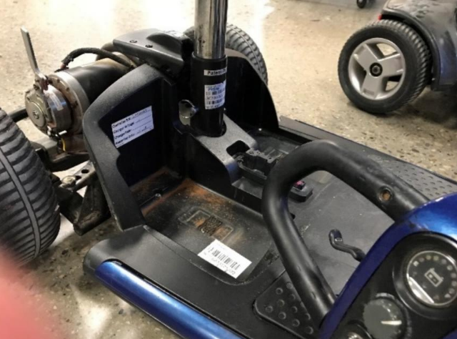
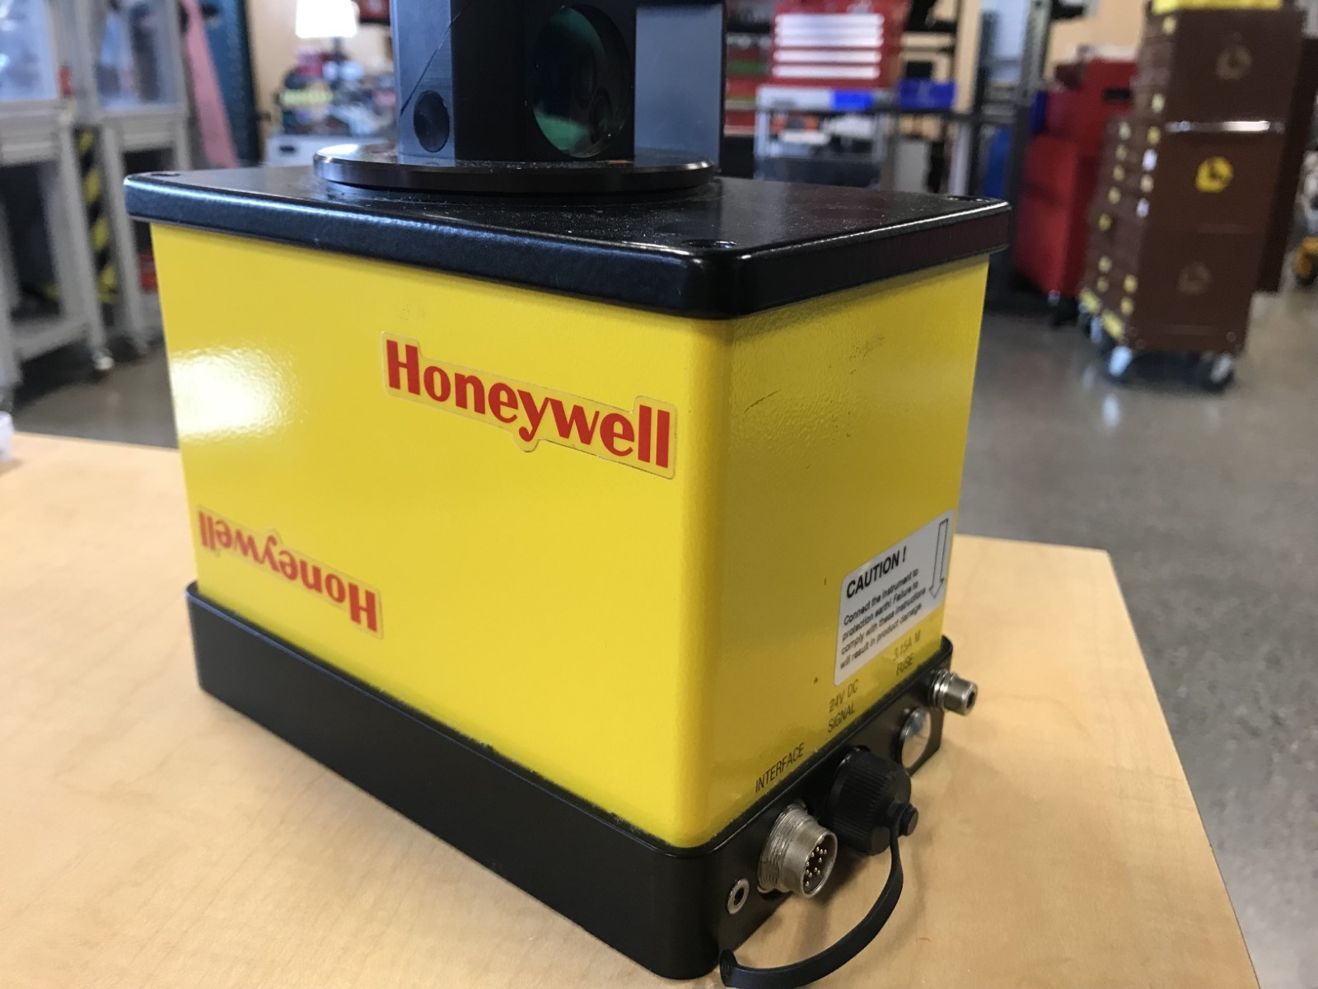
PROJECT BACKGROUND
[1]

Slide 4
problem STATEMENT​
The goal of this capstone project is to create a prototype for an Autonomous Guided Vehicle (AGV) that can navigate between key locations inside the first floor of the Aldred building. We are creating this because SAIT has identified a growing need to transport products and people from one location to another. The AGV must be designed to demonstrate operation under SAIT's safety regulations and guidelines.

Slide 5

Limitations
Appropriate Sizing
Programming
Safety Limitations
Land-based Prototyping
Integration Feasibility
Scalability
End-User Accessibility
Market Viability

Slide 6
constraints
Time and Scheduling
Material Supply and Availability
Cost and Budgeting
Workforce Allocation
Technical Specifications
Regulatory Compliance
Stakeholder Expectations
Environmental Considerations
Innovation Limits

Slide 7
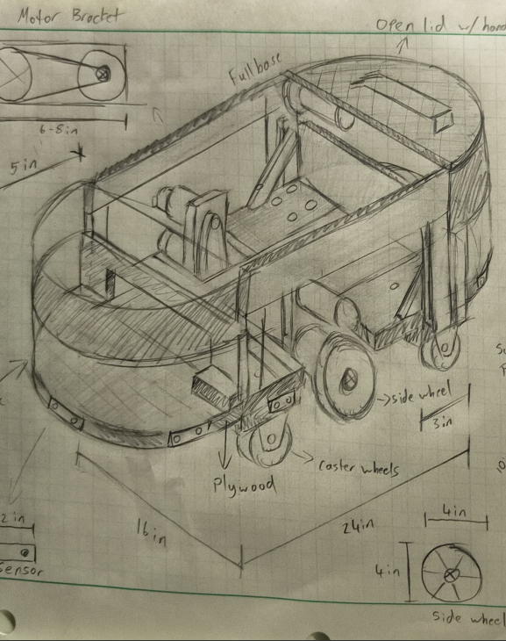
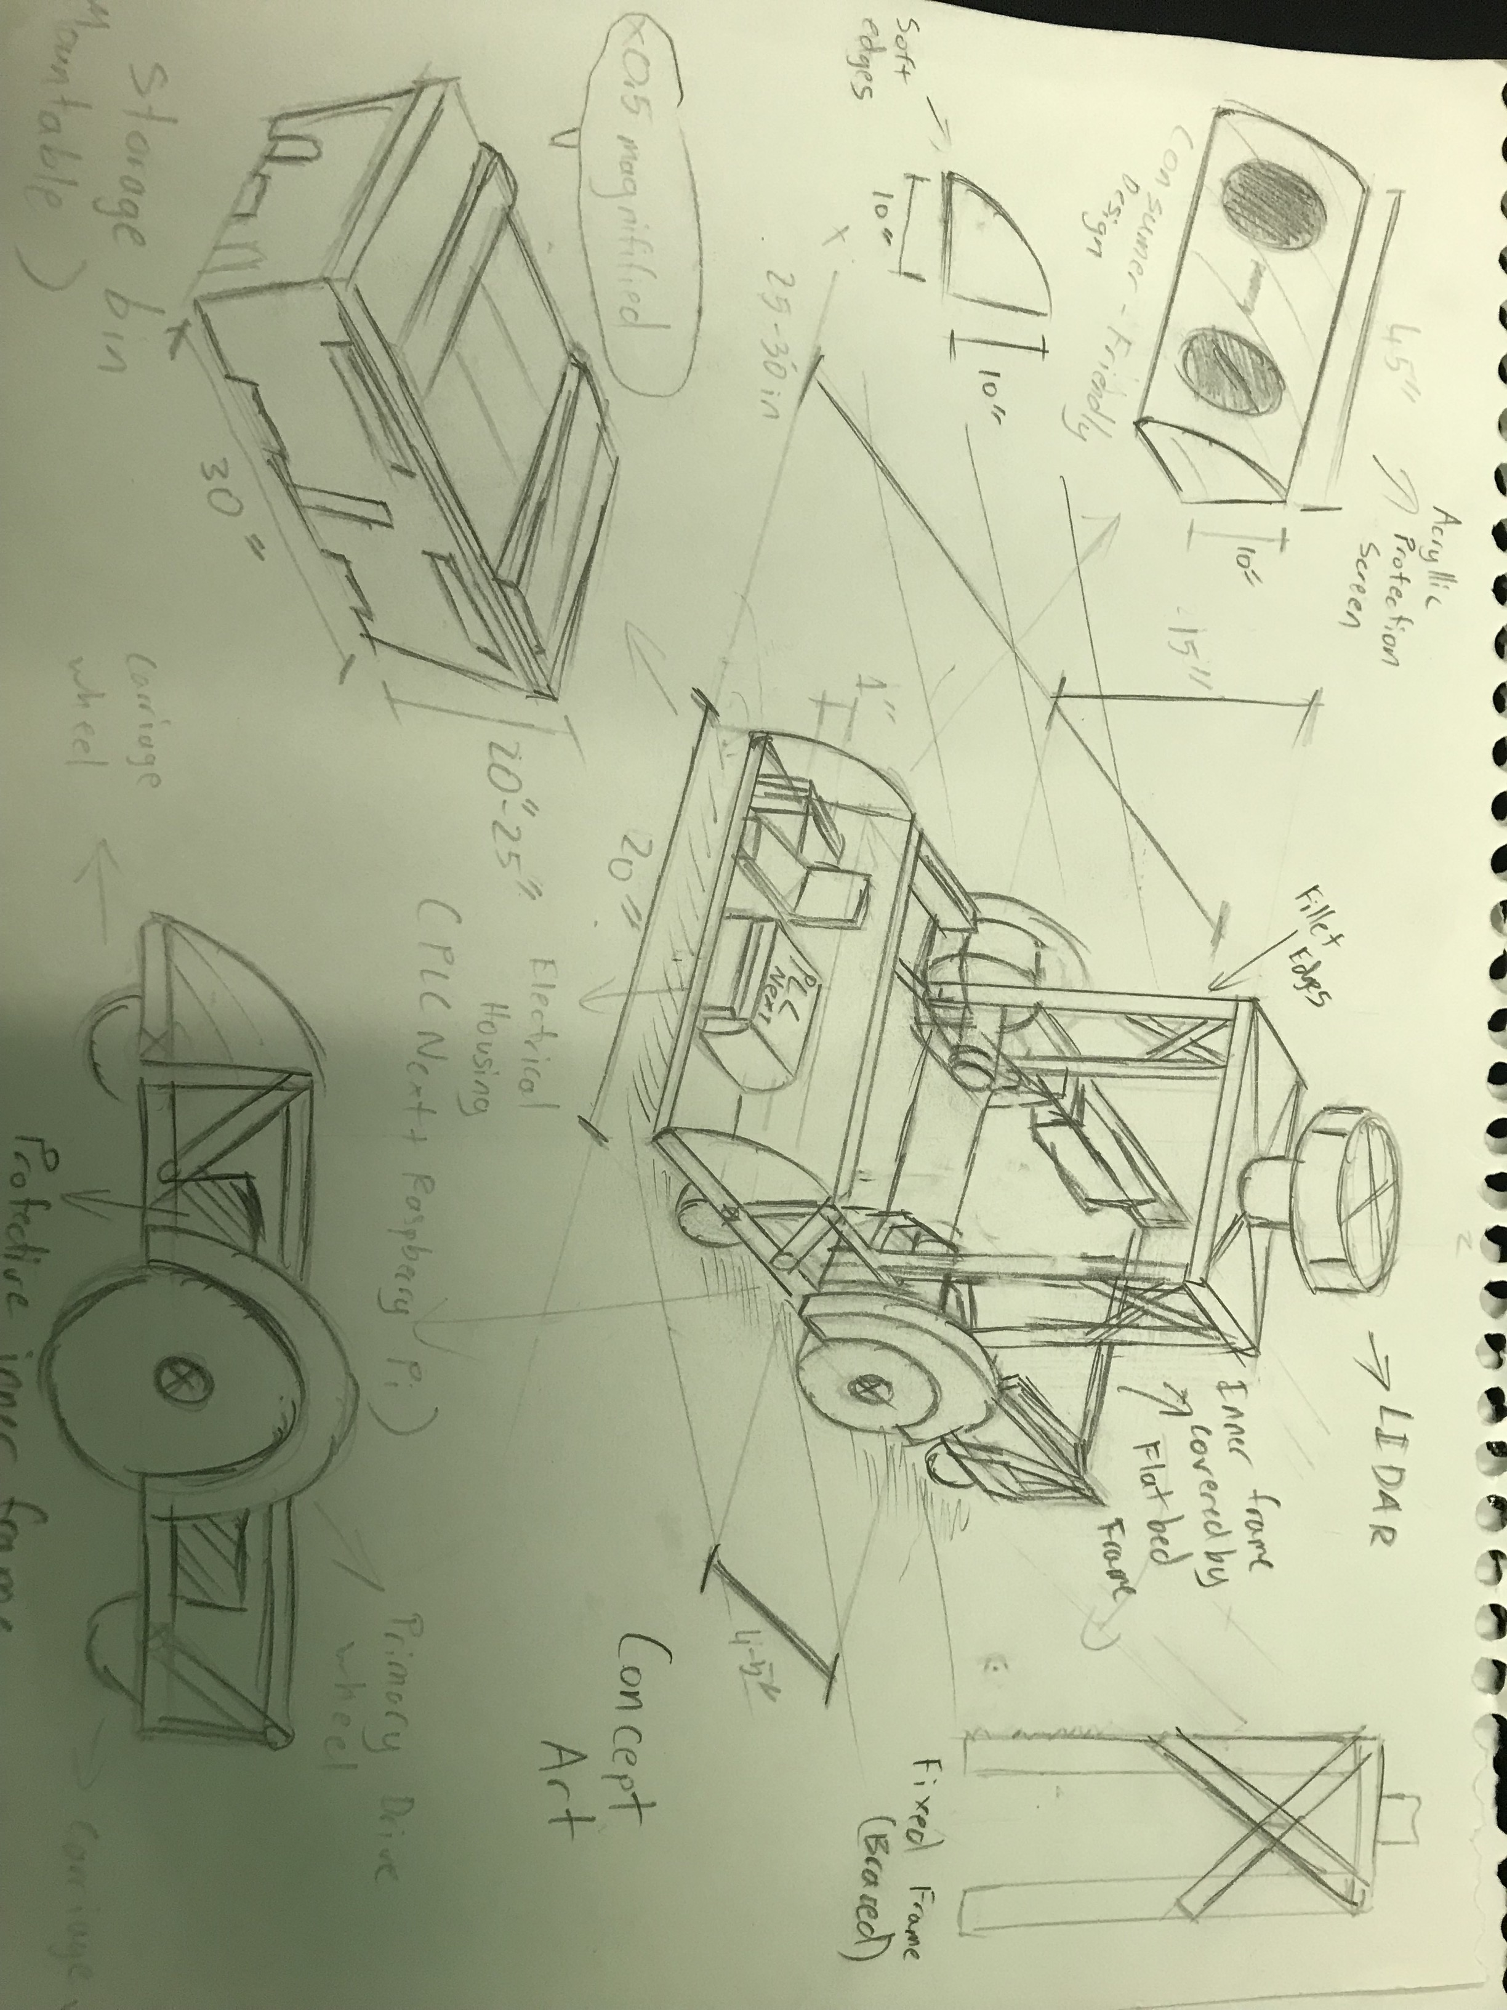
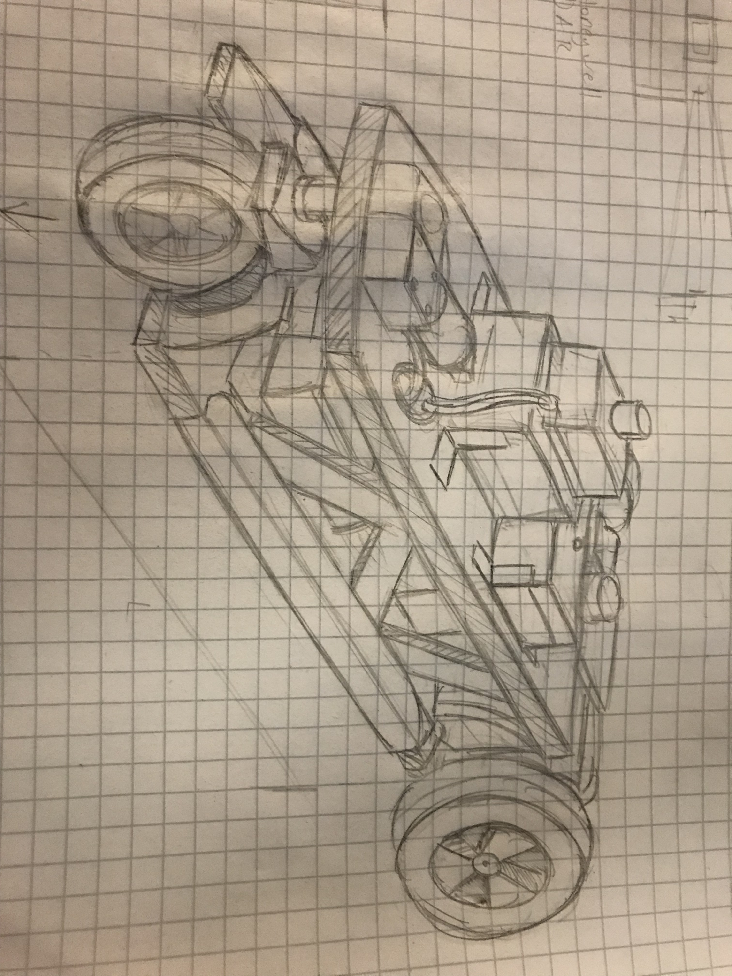
Design Concept

Slide 8

Design Criteria
Objective
Navigation
Size and Capacity
Power Source
Control System
Safety Features
Communication Protocol
Durability
Cost

Slide 9
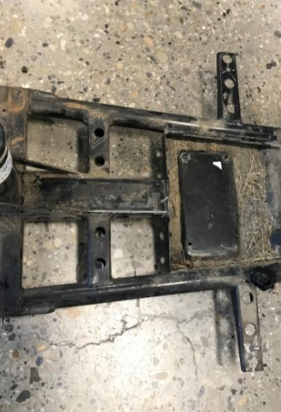
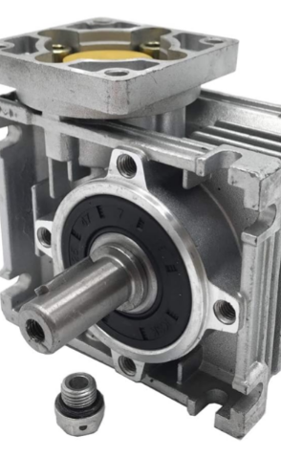
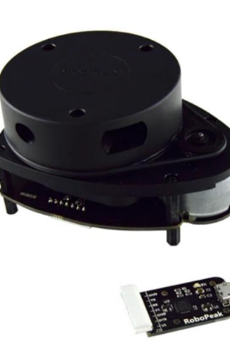
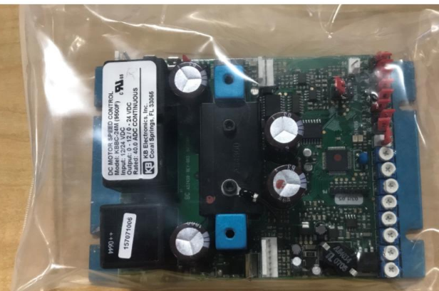
Prototype Development
9
9
9
[3]
9
[2]

Slide 10
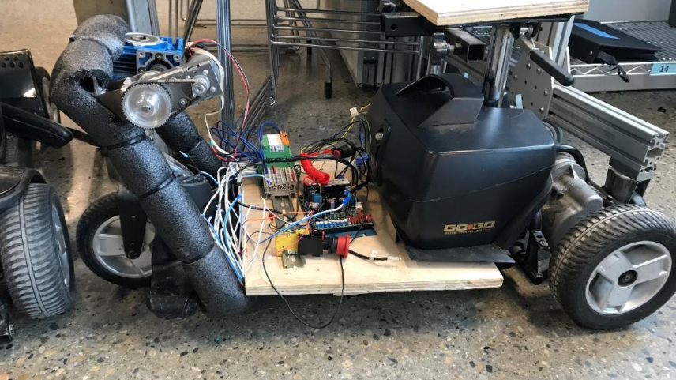
PrototypE Integration

Slide 11
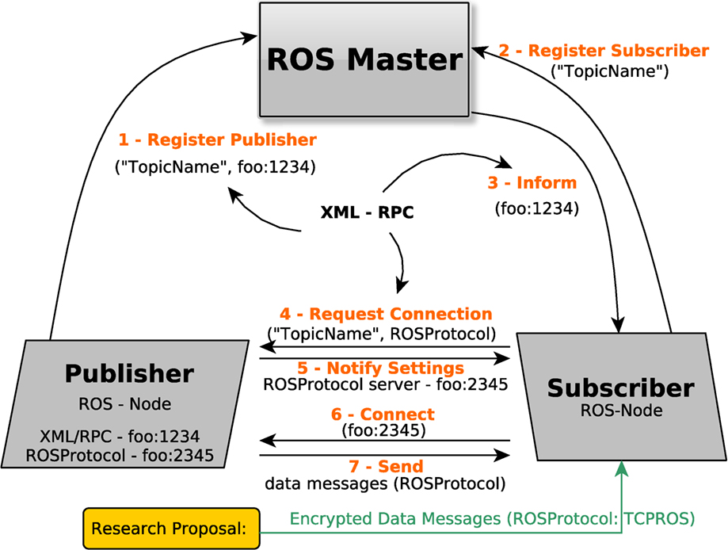
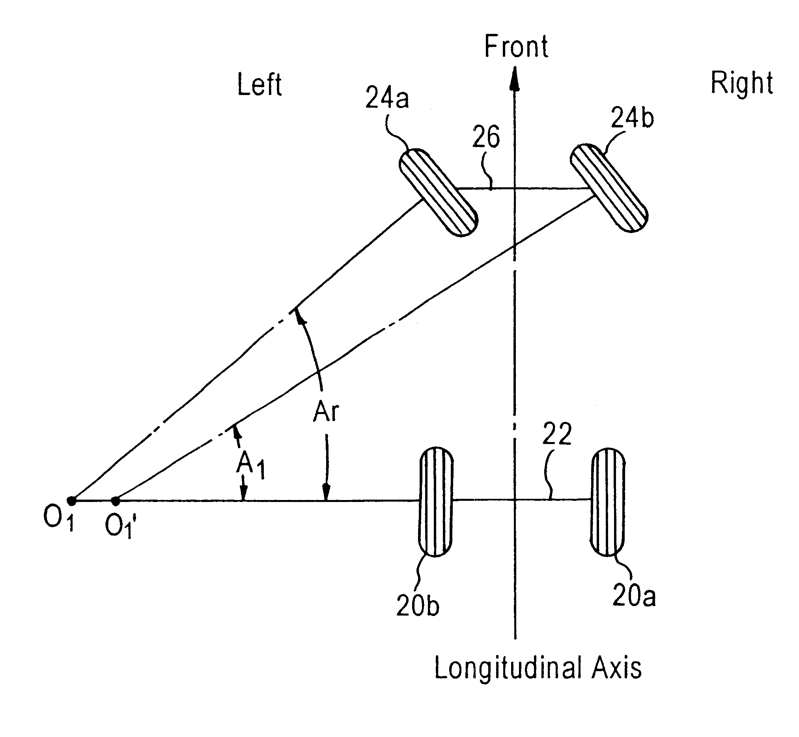
Prototype Testing
Simultaneous localization and mapping (SLAM)
ROS2 nodes
Ackerman Steering System
11
This Photo by Unknown Author is licensed under CC BY
This Photo by Unknown Author is licensed under CC BY-SA

Slide 12
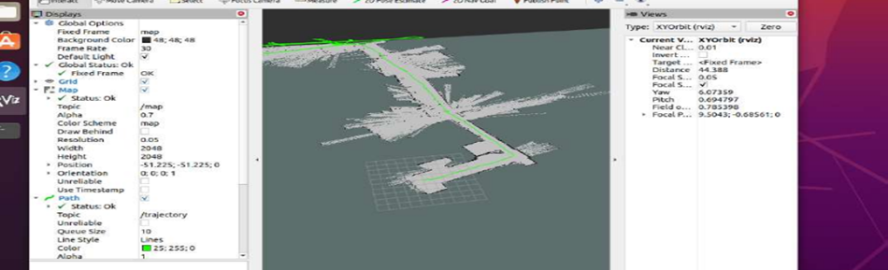
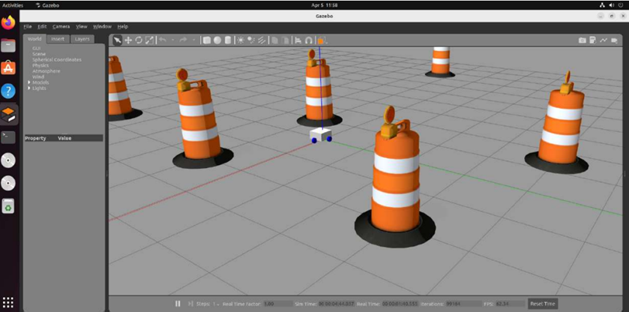
Prototyping Mapping & Navigation

Slide 13

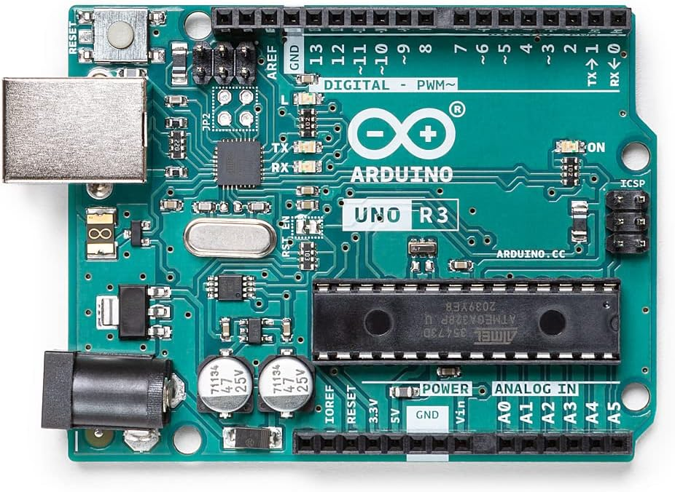
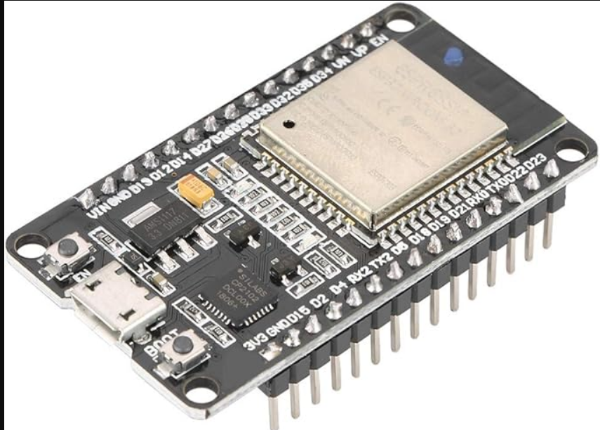
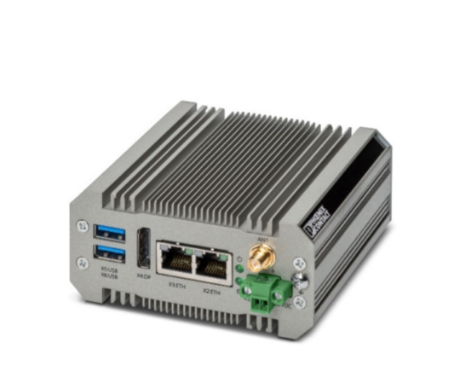
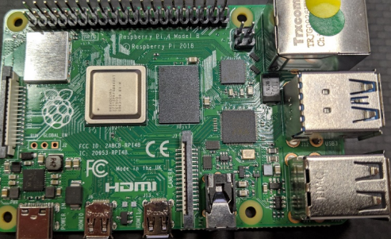

Systems Troubleshooting
[5]
[4]
[6]

Slide 14
Safety Checks
Risk Assessment
Emergency Protocols
Software Safeguards
Mechanical Integrity
Safety Regulations
Continuous Monitoring

Slide 15
final Prototype

Slide 16
Conclusions
Research helped the team with:
Picking the correct LiDAR
Understanding SLAM and ROS
The team discovered that:
BL2 BPC can run VMWare
Integrating motor controller with Arduino is possible
The team was able to:
Create a virtual simulation of autonomous movement
Create an autonomous prototype using a mobility scooter

Slide 17

Recommendations
Prioritize structural maintenance
Improve navigation with nodes
Explore alternative steering methods
Develop elevator use capability
Implement automatic charging
Have multiple different sensors

Slide 18

Questions?

Slide 19

THANK YOU

Slide 20
References [1]“Getting Started with PLCnext Technology,” PLCnext Community. https://www.plcnext-community.net/getting-started-with-plcnext-technology/ (accessed Apr. 20, 2024). [2] “RPLidar A1M8 - 360 Degree Laser Scanner Development Kit,” RobotShop Canada. https://ca.robotshop.com/products/rplidar-a1m8-360-degree-laser-scanner-development-kit ‌ [3]“Worm Gear Speed Reducer NEMA23 Stepper Gearbox Ratio 40:1 for Servo/Stepper Motor : Amazon.ca: Industrial & Scientific,” www.amazon.ca. https://www.amazon.ca/Speed-Reducer-NEMA23-Stepper-Gearbox/dp/B06XGW4DQ1 (accessed Apr. 20, 2024). ‌ [4] “ESP32 Dual Core Development Module Board WiFi+Bluetooth Development Module with ESP32-D0WDQ6 Chip for IOT : Amazon.ca: Electronics,” www.amazon.ca. https://www.amazon.ca/Development-Wireless-Bluetooth-Module-ESP32-D0WDQ6/dp/B07KTV2RRM (accessed Apr. 20, 2024). ‌ [5] “Arduino UNO REV3 [A000066] : Amazon.ca: Electronics,” www.amazon.ca. https://www.amazon.ca/ARDUINO-A000066-Uno-DIP-1-5/dp/B008GRTSV6 ‌ [6]“BL2 BPC 1501S - Box PC - 1130682 | Phoenix Contact,” Phoenixcontact.com, 2018. https://www.phoenixcontact.com/en-il/products/box-pc-bl2-bpc-1501s-1130682 (accessed Apr. 20, 2024). ‌

